Slide 1

Altova SemanticWorks 2012
University of Belgrade
School of Electrical Engineering
Chair of Computer Engineering and
Information Theory
Data Mining and Semantic Web
Miroslav Tišma
tisma.etf@gmail.com

Slide 2
The Semantic Web
The Semantic Web vision was conceived by Tim Berners-Lee, the inventor of the World Wide Web.
In the Semantic Web data itself becomes part of the Web and is able to be processed independently of application, platform, or domain.
The main purpose of the Semantic Web is driving the evolution of the current Web by enabling users to find, share, and combine information more easily.

Slide 3
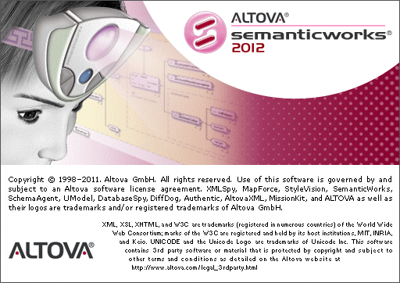
Altova SemanticWorks 2012

Slide 4
Features
Graphical RDF and RDFS editor
Graphical OWL editor
Support for OWL Lite, OWL Full & OWL DL dialect
Tabs for organizing instances, properties, classes, etc.
Syntax and format checking with links to errors
Semantics checking for ontologies
Converting between RDF/XML and N-Triples
RDF/XML and N-Triples code generation

Slide 5
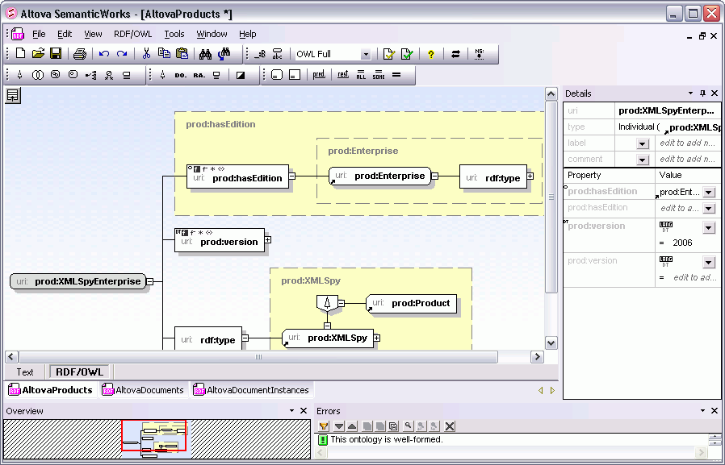
Main window

Slide 6
Visual RDF and RDFS Editing
RDF (Resource Description Framework) is an XML-based standard for describing resources that exist on the Web.
RDFS (RDF Schema) defines vocabularies of RDF resources within a particular domain.
RDF triples consist of a subject, predicate, and object, which correspond to a resource (subject), property (predicate), and property value (object).
RDF also forms the basis of OWL (Web Ontology Language).

Slide 7
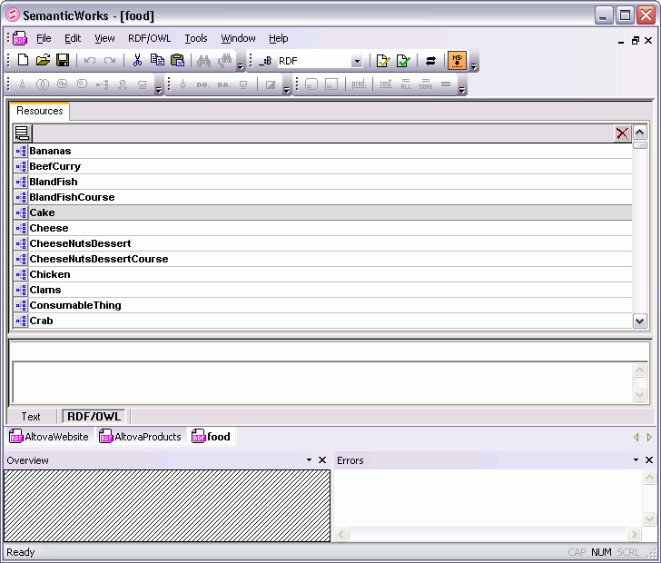
Visual RDF and RDFS Editing
Lists all the resources in your RDF document
on the Resources tab
in the RDF/OWL view.
Creating a new RDF resource is as easy as clicking the insert resource button on the Resources tab, then defining the name for your resource.

Slide 8
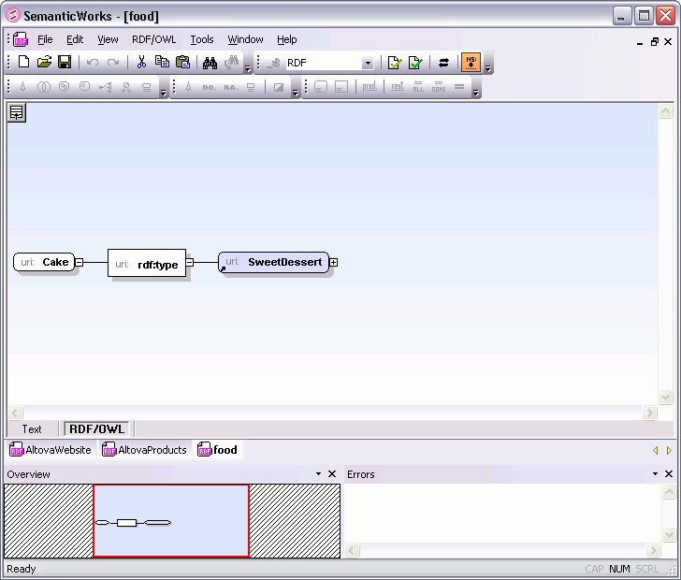
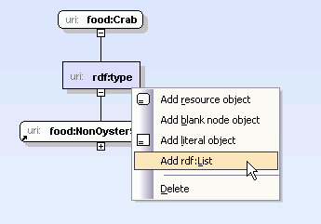
Visual RDF and RDFS Editing
An intelligent right-click menu help you change or add details to the RDF resource quickly and easily
Selecting any of the resources presents you with an RDF graph that displays the associated details.

Slide 9
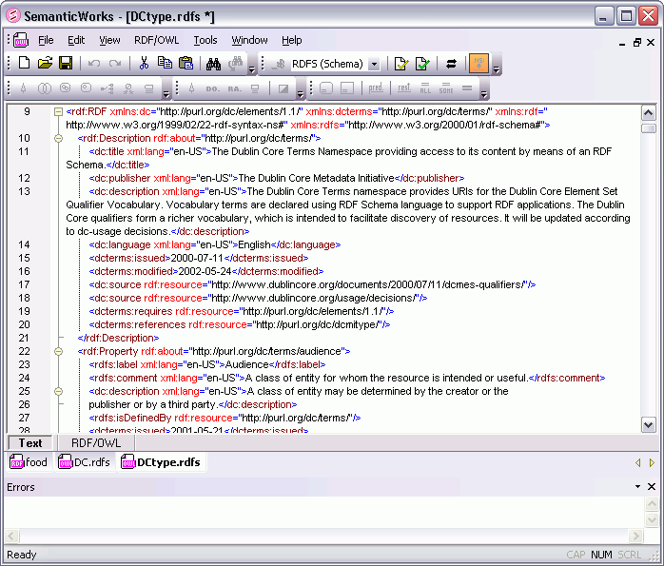
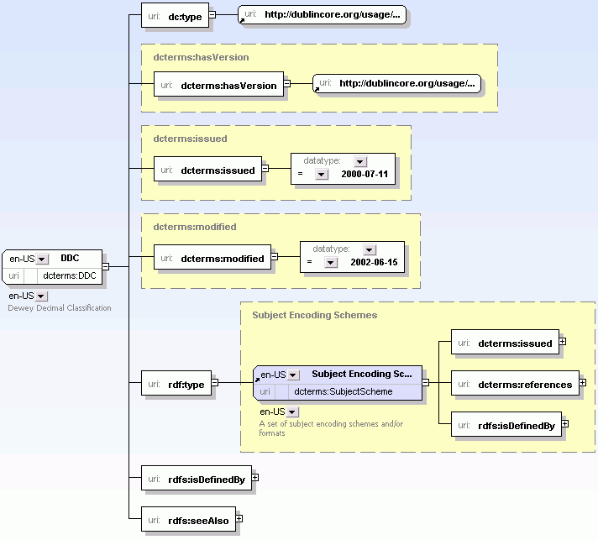
Visual RDF and RDFS Editing
As you’re creating your
visual RDFS design,
SemanticWorks is auto-generating the corresponding RDF/XML or N-Triples code behind the scenes.
SemanticWorks displays resources graphically according to their associations with other resources.

Slide 10
Visual OWL Development
OWL (Web Ontology Language) is an RDF-based language used to create Semantic Web ontologies.
OWL has three sub languages, each with increasing complexity: OWL Lite, OWL DL, and OWL Full.
SemanticWorks allows you to work with existing OWL documents or create new ones from scratch.
You can create complex ontologies visually, using intelligent entry helpers, intuitive icons, time saving shortcuts, etc.

Slide 11
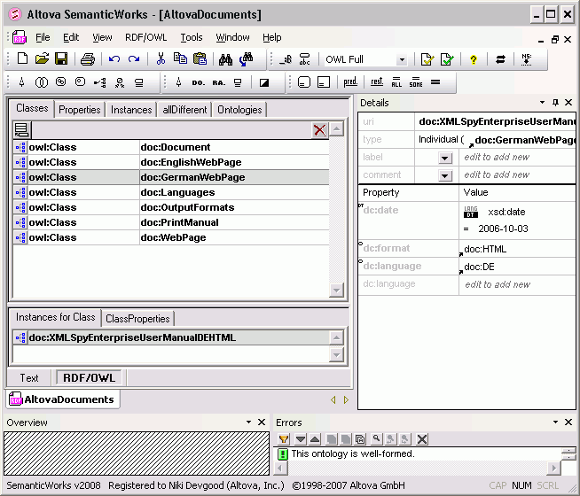
Visual OWL Development
SemanticWorks separates the different components that make up an ontology onto five tabs: Classes, Properties, Instances, allDifferent, and Ontologies.

Slide 12
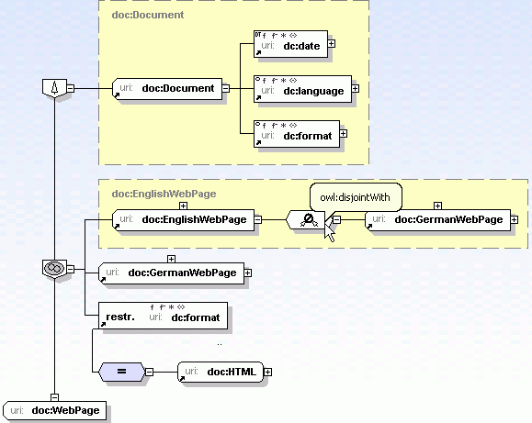
Visual OWL Development
OWL classes are encapsulated in yellow boxes with dashed lines surrounding sub-classes
Holding your mouse over any item or icon listed in the display reveals its meaning or corresponding URI

Slide 13
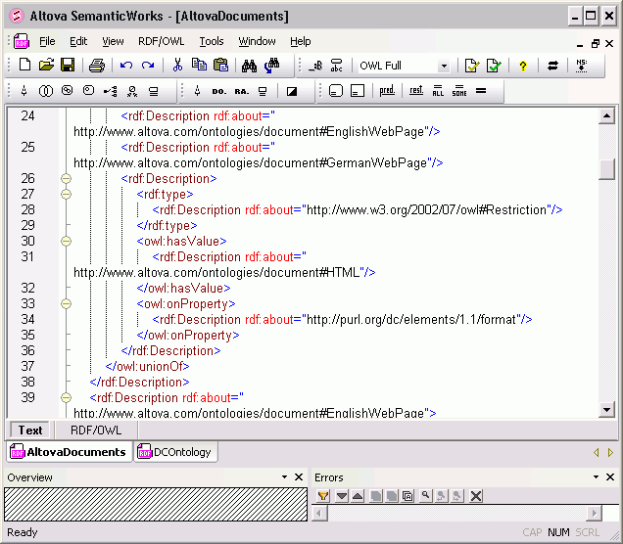
Visual OWL Development
You can select the tab for the editable text view at any time to see how your document is being built in RDF/XML or N-triples
SemanticWorks provides full syntax checking to ensure that your OWL ontology properly conforms to the RDF/XML specifications

Slide 14
Pros and Cons
Pros
Very powerful tool for Semantic Web
Graphical interface looks pretty
You can always find
a better Open Source solution! ☺
Cons
Too confusing to use and poor design overall
It’s not free of charge

Slide 15
Literature
http://www.altova.com/semanticworks.html
http://www.altova.com/semanticworks/rdf-editor.html
http://www.altova.com/semanticworks/owl-editor.html
http://en.wikipedia.org/wiki/Semantic_Web

Slide 16

Thank you for your attention!

